Slide 1





Missouri Commuter Analysis
Martin Carriel, Addison Pietroburgo, Joshua Steinmetz, Scott Stevener
Washington University Data Analytics Boot Camp
Fall 2018

Slide 2
Motivation & Summary
Hypotheses
  H0 = No differences exist between commuting types in metro versus rural counties across Missouri.
  H1 = Differences exist between commuting types in metro versus rural counties across Missouri, where usage of public transit in metro counties is higher.
Questions asked (and why you asked them?)
  How do Missourians commute?
  What differences exist for commuting types across counties in Missouri?
  What differences exist for commuting types within metropolitan areas in Missouri?
(Describe whether you were able to answer these questions to your satisfaction, and briefly summarize your findings)

Slide 3
Questions & Data
How do Missourians commute?
  What commuter trends exist across urban and rural parts of Missouri?
  What differences exist for commuting types across counties in Missouri?
  Are typical commutes similar or do the different metro regions commute in different ways?
Data Sources
  US Census API
  Wikipedia
  Wikilou.com
  MARC.org (Mid-America Regional Council)

Slide 4
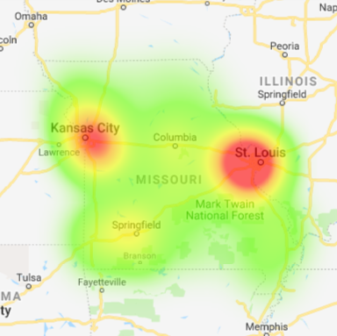
Data Exploration & Cleanup
Used census wrapper to make API calls to get commute data for each county in MO
Calculated commute type %s
Made calls to the Google Maps Geocode API to get coordinates for each county
Created heat map of commuter concentrations
Looked up counties in STL, KC and Springfield Metro Areas & repeated process for counties outside of MO

Slide 5
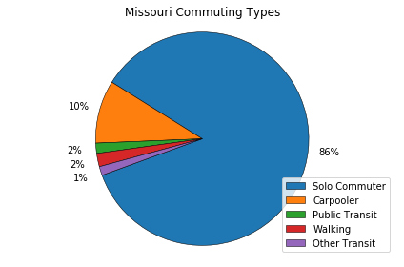
Statewide Analysis
As expected, a massive majority of Missouri commuters are “Solo Commuters”
Commuter proportions very similar county to county. Highest amounts of commuters are located in Kansas City, St. Louis and along I-44.
A very small amount of commuters represented who use public transit, walk or are listed as using “other transit”.
We love our cars!

Slide 6
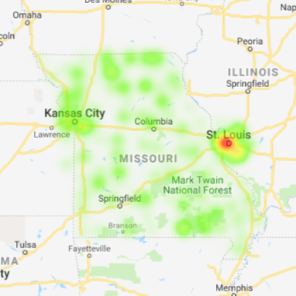
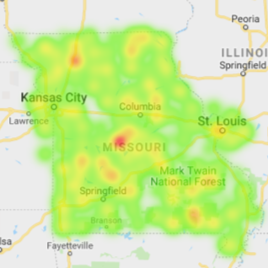
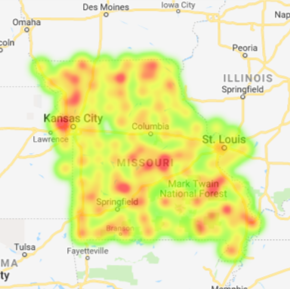
Commute Type Concentrations in MO
Carpooler %
(max. 19%)
- Kansas City
- Jefferson City
- Farmington
Public Transit %
(max. 10%)
- St. Louis
Other Transit %
(max. 5%)
- Ozarks

Slide 7
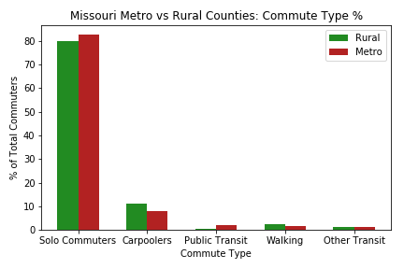
Urban vs. Rural Analysis
Not a very significant level of difference.
By conducting an independent t-test it was found that rural areas do have a decently higher amount of carpoolers and walking commuters.
This could be due to people living in closer proximity to their place of work in rural areas.

Slide 8
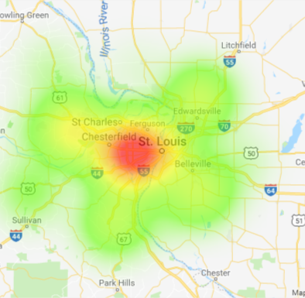
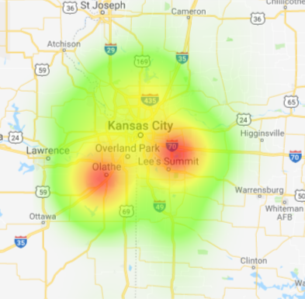
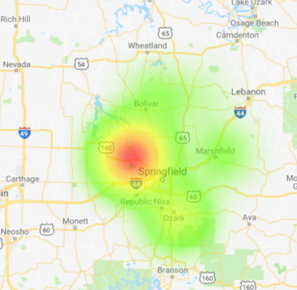
Heat Maps of MO MSAs

Slide 9
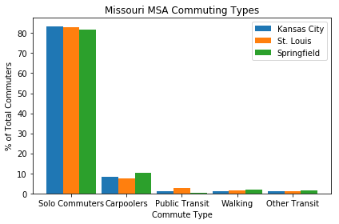
Metro Areas Analysis
An ANOVA test revealed significant differences for commute types % between the cities.
A T-Test showed Carpooler % between Kansas City and St. Louis to be significant
Visually notable differences include amount of carpoolers and amount of walking commuters in Springfield.
This could be due to higher percentage of people living/working near or on a college campus.

Slide 10
Discussion
Driving to work alone is seem as the best option by the overwhelming majority of commuters.
Commuters do not have commuting options other than solo commuting.
Commuters do not see options other than solo commuting as a viable way to get to work.
The option to use public transit exists mainly in urban areas.
Even in urban areas where public transit is available, Missourians do not use it for commuting.

Slide 11
Post-Mortem
Metropolitan areas of Missouri range from nearly 3 million in population (St Louis) to around 150,000 (Columbia)
  We chose to classify the three most densely populated areas “metro” or urban and all remaining counties as “rural”
Given additional time additional details to analyze include:
  Find sources including time of commute
  Find sources including distance of commute

Slide 12
Post-Mortem
Other data that could offer relevant information include:
  Average commute type across urban and rural regions including age, education, and income data
We found that rural and urban regions of Missouri did not differ dramatically in commuting behavior.
  Expanding this study to include additional states and regions of different sizes could provide different results

Slide 13
Questions?

